Slide 1
Customer Feedback Analysis - British Airways
Sentiment Insights & Key Themes from Customer Reviews
Presented by : Gurleen Kaur Bali

Slide 2
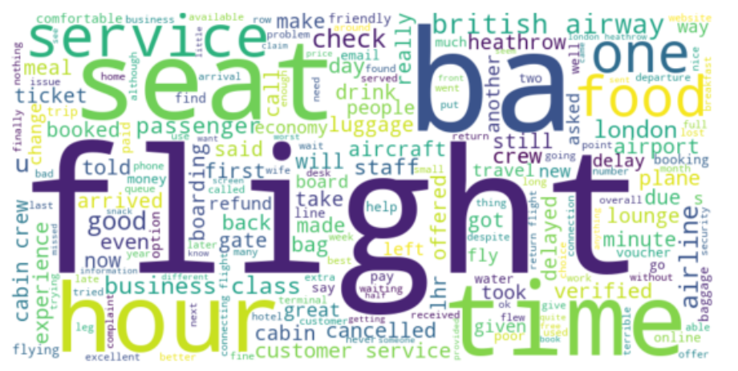
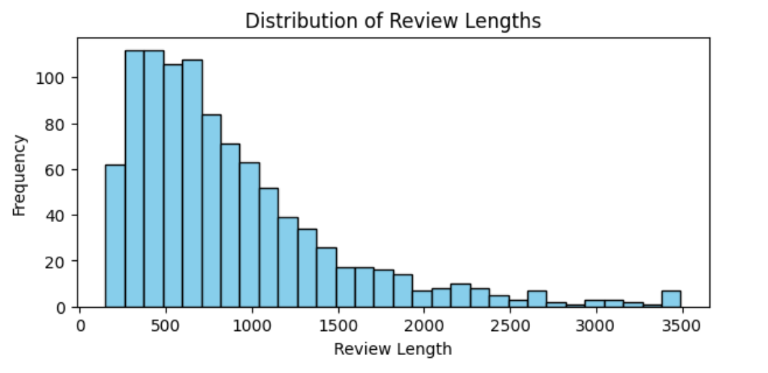
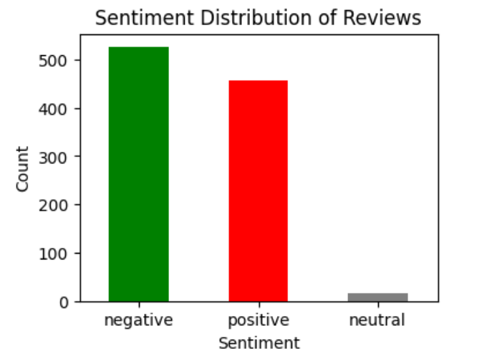
Customer Sentiment Analysis
Word cloud:
Positive Sentiment: 457 reviews are positive, highlighting satisfaction with overall service, comfort, and in-flight experience.
Negative Sentiment: 527 reviews reflect dissatisfaction, primarily due to delays, customer service issues, and baggage handling.
Neutral Sentiment: 16 reviews are neutral, indicating mixed or indifferent customer experiences.
The Word Cloud visualizes the most frequently used words in the customer reviews.
Distribution of Review Lengths
The distribution of review lengths shows the variation in the amount of feedback provided by customers.

